Slide 1
HYSTEROCOPIC SURGERY AND SUCCESS OF IVF/ICSI
Prof .dr. Tomaž Tomaževič
Ljubljana, Slovenia
Brioni , 5-8 september 2013

Slide 2
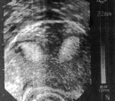

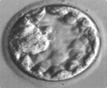
Uncredible progress of infertility treatment during last 30 years
Not only because of fantastic development of endocrinology and IVF, but also because of better diagnostics (VUS) and less invasive surgical treatment .
Due to the progress, today we also better understand the clinical importance of uterine infertility factor.

Slide 3
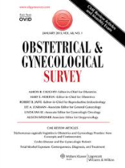

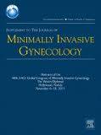

Today it is clear that the presence of various intrauterine abnormalities is associated with decreased fertility
Therefore it is important to look at the role of hysteroscopic surgery in the modern infertility treatment .

Slide 4
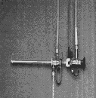
Hysteroscopic surgery in natural conception ?
Thirty years ago the uterine infertility factor seemed to be rarely present and to be rather unimportant.
Because of results in many observational studies on hysteroscopic surgery, reporting good results in terms of fertility and pregnancy outcomes , the views on clinical importance of uterine infertility factor have slowly been altered.
The importance of uterine abnormalities as infertility factors in natural conception has only recently been prooven in five prospective control studies: on hysteroscopic myomectomy and hysteroscopic metroplasty in unexplained infertility .
Studies clearly showed : that ubmucous myomas and uterine septae decrease and hysteroscopy metroplasty improves natural fertility ( Casini 2006, Shokeir T 20010, Pabuccu 2004, Mollo 2009, Shokeir 2011).

Slide 5
Hysteroscopic surgery in IVF/ICSI?
Hysteroscopic surgery was introduced to improve outcomes in pregnancies after IVF/ICSI.
With the use of IVF/ICSI we by passed all infertility factors except uterus and embryo.
By studying the results of IUI and IVF/ICSI in women with treated , non treated and no uterine disorders we got new clinical informations on uterine disorders and infertility

Slide 6
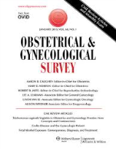
According to Pavone et al., based on evidence, uterine evaluation has become an important part of modern simplified infertility treatment
In the review article by T . Tulandi and Akkour K.
Role of reproductive surgery in the era of assisted reproductive technology In the Journal. Clinical Obstetrics and Gynaecology Best Practice & Research 26 (2012) 747–755
Authors say, that based on evidence, hysteroscopic correction of intrauterine disorders is an important endoscopic procedure in women with infertility.
Pavone M E et al. Simplification of modern infertility treatment Obstetrial & Gynecological Survey 2011

Slide 7
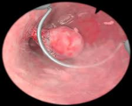

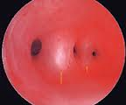
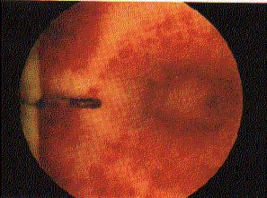
Let us see the evidences. In the T. Tulandi review papers, the following evidence based papers on hysteroscopic surgery, uterine disorders and infertility, have been cited :
The study by Perez Medina et al (2005) (polyps) .
The study by Shokeir et al, (2010) ( submucous myoma)
The Study by Tomazevic et al. (2010) (hysteroscopic metroplasty)
No study ( hysteroscopic adhaesiolysis)

Slide 8

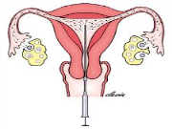
:
Perez Medina et al.. In Hum Reprod 2005; 20: 1632–1635 published a prospective randomised-controlled trial : 215 women with up to four IUI treatment cycles were included
Study : Polypectomy (N=107)
Control :Biopsy (N=108).
Furthermore, more than one-half of women in the polypectomy group conceived spontaneously within 3 months after surgery.

Slide 9
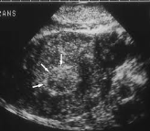
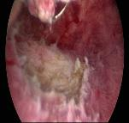
Shokeir et al. In Fertil. Steril. 2010;94:724–729 published a prospective randomised control trial on hysteroscopic myomectomy and natural conception
Submucous myomas and their implications in the pregnancy rates of patients with otherwise unexplaind infertility undergoing hysteroscopic myomectomy
:
St N= 101 vs. C N=103
RR 2,1 . 95% CI 1.5-2,9
.
A meta-analysis supported these findings (Pritts 2009). (RR, 0.36%; 95% CI, 0.18–0.74).
The miscarriage rate decreased after surgery
.

Slide 10
The results by Shokeir et-al. in natural conception, agree with findings of Eldar_ Geva T et al. in assisted conception (1998)
Eldar-Geva T, Meagher S, Healy DL, MacLachlan V, Breheny
Wood C Fertil Steril . 1998 Oct;70(4):6 87-91
Effect of intramural, subserosal, submucosal uterine fibroids and no fibroid on the IVF
A retrospective comparative study :
106 study vs. 318 control cycles

Slide 11


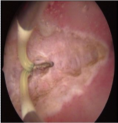

Tomazevic T, Ban H et al published a retrospective matched control study - Septate, subseptate and arcuate uterus decrease pregnancy and live birth rates in IVF/ICSI - RBMO 2010; 21: 700-705
In a matched control study they evaluated the effect of uterine septum on IVF outcome among 2481 embryo transfers in IVF and ICSI cycles.

Slide 12



1) Ban H , Tomaževič T et al. Outcome of singleton pregnancies after IVF /ICSI in women before and after resection of uterine septum compared to normal controls. Matched control study. EJOGRB 2009 ; 146:184-87 .
.
Study N =31 vs. Control N = 62
411 singleton IVF pregnancies ( FHR +) were included.
Uterine septum increases spontaneous abortion in singleton IVF pregnancies
(OR: 12- 15 )
P<0.001
AFS 6 AFS 5
After surgery the differences disappeared

Slide 13
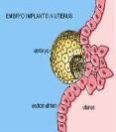
2) Tomaževič T, Ban H et al . : Septate, subseptate and arcuate uterus decrease pregnancy rate in IVF/ICSI: matched control study - 2481 ETs. :
:
OR 7.0 for larger and
OR 2.5 for arcuate uterus
(P<0.001) .
After surgery the differences in pregnancy rate disappeared

Slide 14

3) Tomaževič T, Ban H et al . Septate, subseptate and arcuate uterus decrease live birth rate in IVF/ICSI: -
RBMO 2010; 21: 700-705
OR 30 for larger and
OR 15 for arcuate uterus –
P<0.001)
After surgery the differences in live birth rates disappeared

Slide 15



Metanalysis of the published results supported the finding that hysteroscopic metroplasty improves the succeess in IVF/ET (Valle 2013)
Valle et al. Hysteroscopic Metroplasty for the Septate Uterus: Review and Meta-Analysis Journal of Minimally Invasive Gynecology, 2013.

Slide 16
Paucity of evidence on the importance of hysteroscopic adhesiolysis in ART
Hysteroscopic adhaesiolysis favourably influences menstraul irregularities and infertility .
The results in terms of pregnancy rates after hysteroscopic adaesiolysis depends on extension, severity of adhesions :
mild 88-100%
moderate 67%-84%
in severe 28% - 57%.
The success of hysteroscopic operations.
Tulandi T : Although there is paucity of evidence it is logical to create normal uterine environment before IVF /ICSI treatment

Slide 17

Conclusions
Uterine evaluation and hysteroscopic surgical treatment serves to optimise the success of IVF/ICSI.
Mutatis mutandis it serves also to optimise natural conception and success of naturally concieved pregnancies.
.
Two sailors on board ( Adriatic 2012)
Thank you for
your attention

